Slide 1

TEXT SUMMARIZATION USING DEEP LEARNING
Prepared by:
Azmina Vanzara
Neel Patel
Nidhi Rana
Guided by:
Dr. Ziad Kobti
This Photo by Unknown author is licensed under CC BY-SA-NC.

Slide 2

Overview
Motivation
Problem Statement
Hypothesis
Approach & Tools
Model
Demo
Results
Conclusion
Future Work
References

Slide 3
Motivation
A common situation we encounter now-a-days: "I don't need a full report, simply provide me with a rundown of the outcomes"
Manual summarization of a lengthy document/article is time-consuming

Slide 4
Problem Statement
Developing a model that can understand the context of a document written in a Natural Language (i.e., Human Language), and successfully summarize it in a human understandable and readable format

Slide 5
Hypothesis
Text summarization is the process of producing concise summary while retaining key content of the document and its meaning
Approaches for Text Summarization:
Abstractive Summarization
Extractive Summarization

Slide 6
Approach & Tools
Chosen Method: Abstractive
Modeling Approach: Sequence-to-Sequence (Encoder-Decoder)
Programming Language: Python
Machine-Learning Libraries: Tensorflow, Keras
NLP Libraries: NLTK

Slide 7
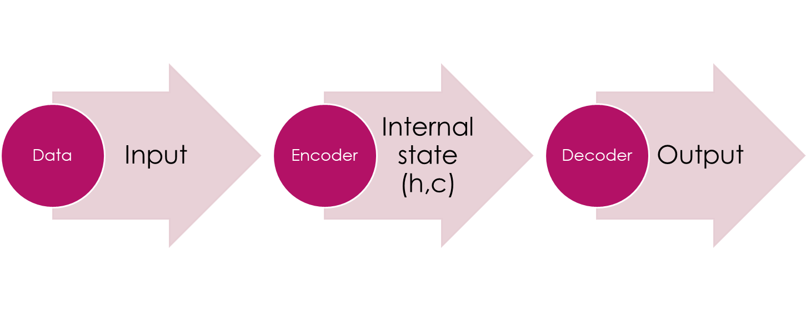
Model

Slide 8

Demo

Slide 9
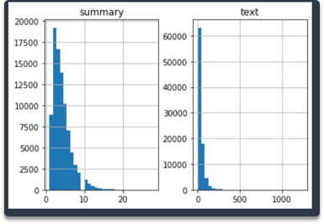
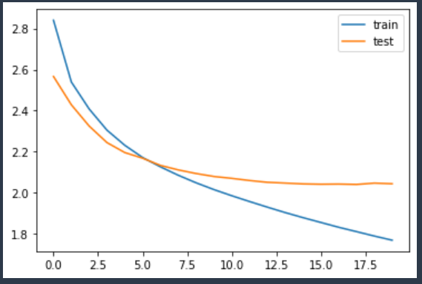
Results

Slide 10
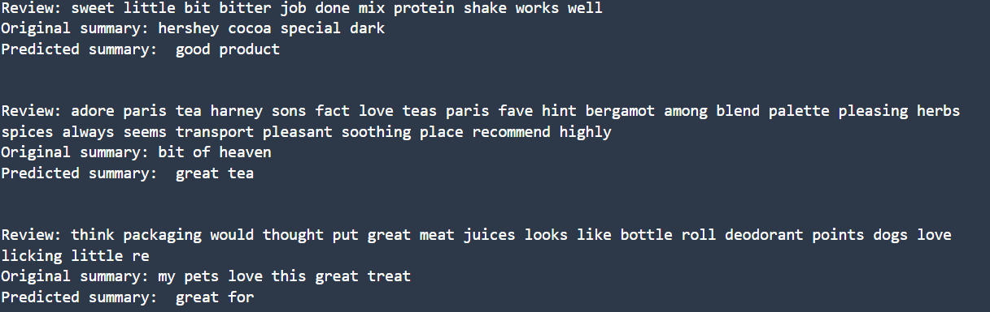
Results

Slide 11
Conclusion
We have successfully trained a model that can perform abstractive summarization
Limitations:
It works for small sequences only
Encoder is unable to memorize long sequences into a fixed-vector length

Slide 12
Future Work
Improve the model performance by:
Implementing Attention Layer mechanism
Implementing bi-directional LSTM to capture context from both directions
Applying Beam-Search strategy to decode the test sequence

Slide 13
References
Rahman, & Siddiqui, F. H. (2021). Multi‐layered attentional peephole convolutional LSTM for abstractive text summarization. ETRI Journal, 43(2), 288–298. https://doi.org/10.4218/etrij.2019-0016
Lal, Singh, K. P., & Tiwary, U. S. (2022). ICE: Information coverage estimate for automatic evaluation abstractive summaries. Expert Systems with Applications, 189, 116064–. https://doi.org/10.1016/j.eswa.2021.116064
GitHub Repository: https://github.com/azmeena1311/text_summarizer

Slide 14
THANK YOU!
ANY QUESTIONS?

